Slide 1



Categories of Networks, Internet and Protocols, Standards and Organizations Session No.: 3 Course Name: Data Communication and Networking Course Code: R1UC406B Instructor Name: Abadhan Sabyasachi Duration: 50 mins Date of Conduction of Class:

Slide 2
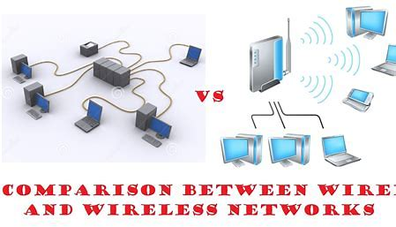
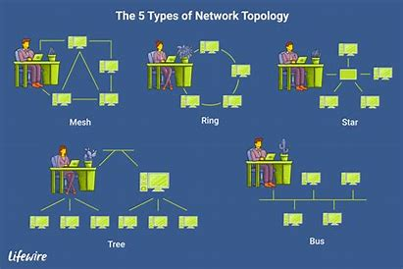
Some key concepts of session no. 2
Type of Connection in a Network
(Wired vs. Wireless Network)
Various Physical Topologies in a Network

Slide 3
1. | Which of the following network topologies connects all devices in a closed-loop, where each device is connected to exactly two other devices? | 2. | Which of the following is an example of a wireless network connection?
 | A) Star Topology B) Ring Topology C) Bus Topology D) Mesh Topology |  | A) Fiber Optic Cable B) Ethernet C) Wi-Fi D) Coaxial Cable

Slide 4
Which type of network is best suited for connecting multiple computers in a small office or home setting ?

Slide 5
Which type of network is best suited for connecting multiple computers in a small office or home setting ?
This question will reinforces the understanding of network types and their practical applications, as covered in today’s session.

Slide 6
At the end of this session, students will be able to
Learning Outcome 1:
Differentiate between LAN, WAN, and MAN, Internet Protocols and Standards.
Learning Outcome 2:
Analyse the real-time scenario for network types, protocols, and standards.

Slide 7
Session Outline
1. Definition of Network
2. Types of Networks
3. Comparison between LAN, WAN, MAN
4. The Internet
5. Internet Protocols
6. Standards and Organizations

Slide 8
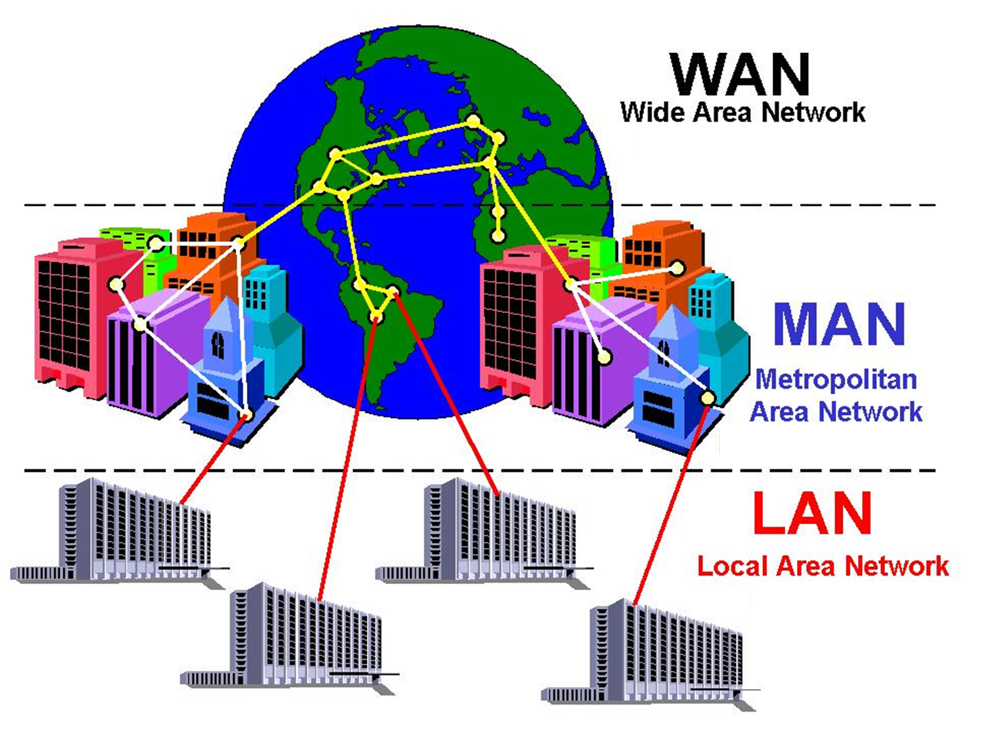
Categories of Networks:
In the field of Data Communication and Networking, a Network is a system of interconnected devices (such as computers, servers, routers, and switches) that communicate to share data, resources, and services.
A network enables seamless data sharing, communication, and resource utilization, making it the backbone of modern digital communication.
Networks can be classified based on their size, geographical coverage, and purpose. Based on geographical coverage, it is classified as :
Local Area Network (LAN)
Wide Area Network (WAN)
Metropolitan Area Network (MAN)

Slide 9
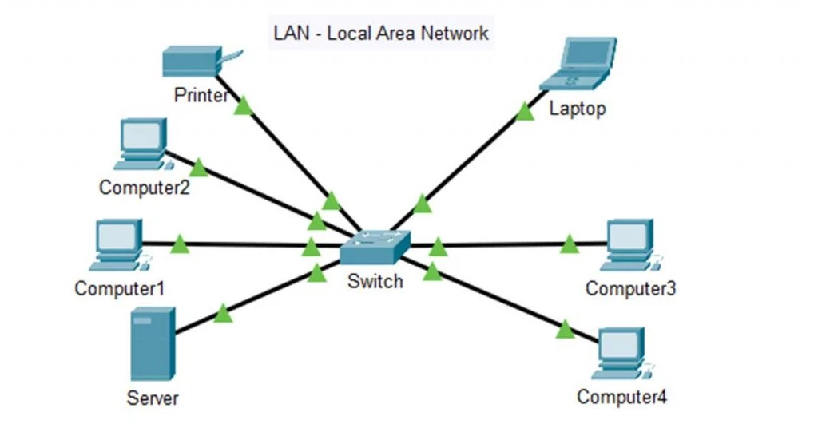
Local Area Network (LAN):
Definition: | A network that connects computers within a small area (e.g., home, office, school).
Examples: | Office networks, campus networks, home Wi-Fi.
Advantages: | High speed, low cost, secure data sharing.
Disadvantages: | Limited range, requires maintenance.
Identify where you have seen a LAN in use.

Slide 10
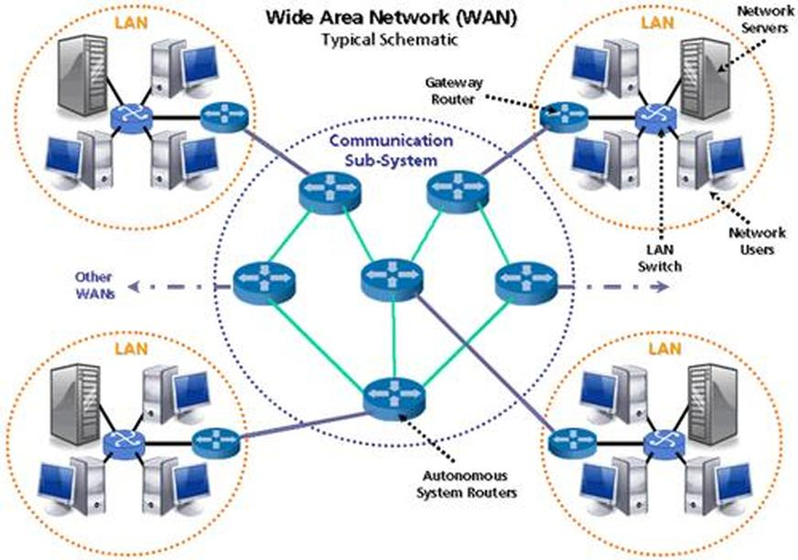
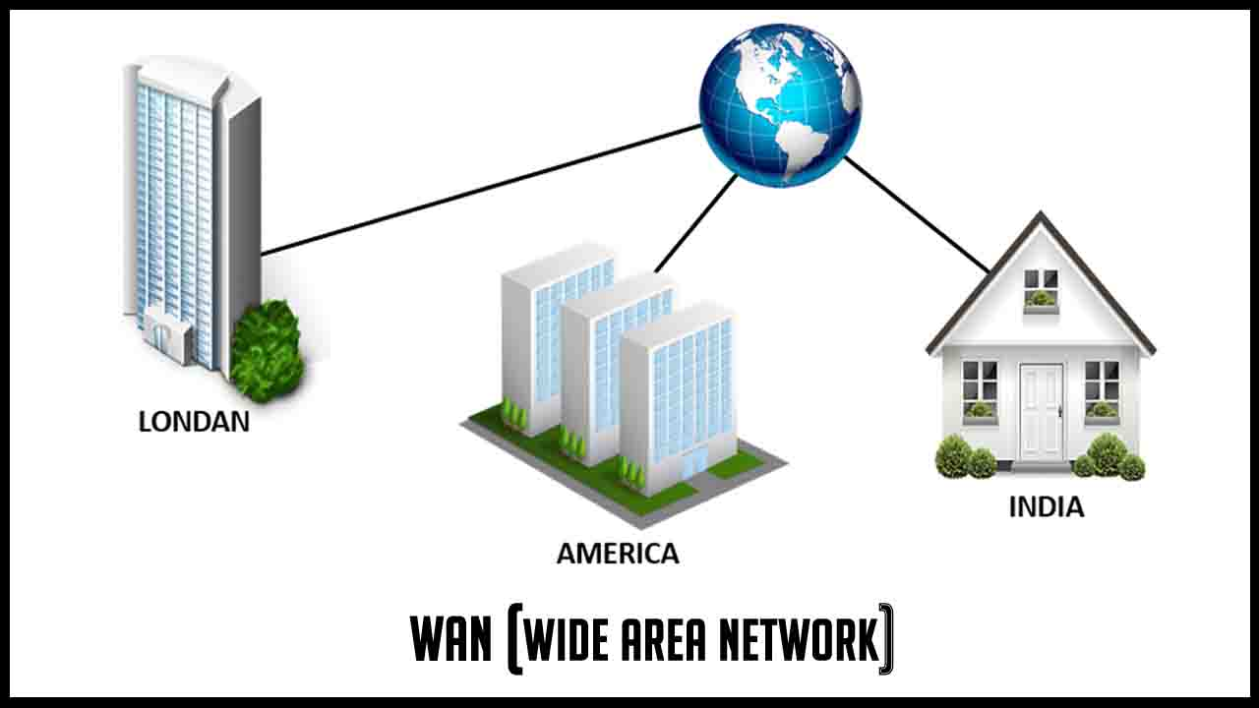
Wide Area Network (WAN):
Definition: | A network that covers large geographical areas such as countries or continents.
Examples: | The internet, multinational corporate networks.
Advantages: | Connects multiple LANs and therefore Global connectivity, remote access.
Disadvantages: | High cost, slower speeds, requires advanced security measures.

Slide 11
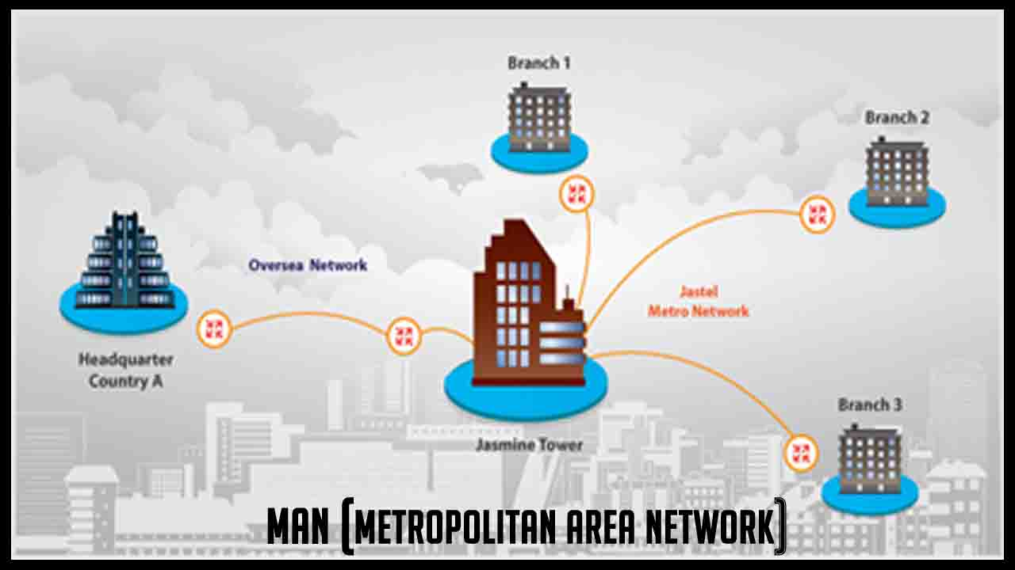
Metropolitan Area Network (MAN):
Definition: | A network that spans a city or a large campus, larger than LAN but smaller than WAN.
Examples: | often uses fiber optics such as University networks, city-wide Wi-Fi, cable TV networks.
Advantages: | Covers a larger area than LAN, efficient communication.
Disadvantages: | Higher cost, potential data congestion.

Slide 12

Learning Activity 1 (Woo Flash Quiz):

Slide 13
Comparison: LAN vs. WAN vs. MAN
Feature | LAN | WAN | MAN
Coverage | Small (Building) | Large (Country/Globe) | Medium (City)
Speed | High | Low | Moderate
Cost | Low | High | Moderate
Example | Home Wi-Fi | Internet | City Wi-Fi
Advantages & Disadvantages:
LAN: High speed, secure, low cost but limited to a small area.
WAN: Connects distant locations, but expensive and slower.
MAN: Covers a city, cost-effective, but requires maintenance.

Slide 14
The Internet
Global network of interconnected networks
Based on TCP/IP protocol suite
Uses packet switching
Provides WWW, Email, FTP services

Slide 15
OSI Reference Model (7 Layers)
Application
Presentation
Session
Transport
Network
Data Link
Physical

Slide 16
TCP/IP Model (5 Layers)
Application
Transport
Network
Data Link
Physical

Slide 17
OSI vs TCP/IP Comparison
Feature | OSI Model | TCP/IP Model
Layers | 7 Layers | 4 Layers
Nature | Conceptual | Practical
Developed By | ISO | DARPA
Usage | Reference Model | Internet Model

Slide 18
Internet Protocols
TCP – Reliable, connection-oriented
UDP – Fast, connectionless
HTTP – Web communication
FTP – File transfer
SMTP – Email sending

Slide 19
IPv4 vs IPv6
Feature | IPv4 | IPv6
Address Size | 32-bit | 128-bit
Notation | Decimal | Hexadecimal
Example | 192.168.1.1 | 2001:0db8::1

Slide 20
Need for Standards
Interoperability
Compatibility
Uniform communication
Global acceptance

Slide 21
Types of Standards
De facto
De jure
Open standards
Proprietary standards
Galgotias University

Slide 22
Standard Organizations
Organization | Full Form | Contribution
ISO | International Organization for Standardization | OSI Model
IEEE | Institute of Electrical and Electronics Engineers | 802 Standards
IETF | Internet Engineering Task Force | RFC Standards
ITU | International Telecommunication Union | Telecom Standards

Slide 23
Activity-2 (Role-Playing Exercise):
Every table is assigned with different university name some of which are of same city, some are of different city/country (GU, Sharda, Bennett, GLA Mathura, IIT Kanpur, NIT Kkr, NIT Hamirpur, NTU Singapore, NIT Delhi, NTU Taiwan, Stanford University USA, Oxford University UK ).
Now, have them decide which network type they would use to share resources on same table or different table and why? Moreover, what are pros. and cons. of each ?

Slide 24
Ensure attainment of LOs in alignment to the learning activities: outcomes (1-2)
Outcome 1:
Definition, examples advantage and disadvantage of all the three network (i.e. LAN, WAN, and MAN), Internet Protocols and Standartds are discussed.
Outcome 2:
A real-time scenario is discussed to illustrate the types of networks and the Internet protocols and standards, along with proper justification.

